Slide 1
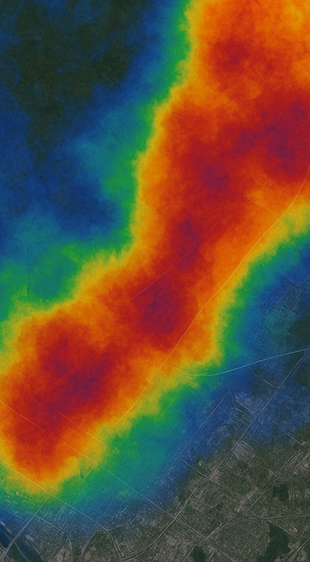
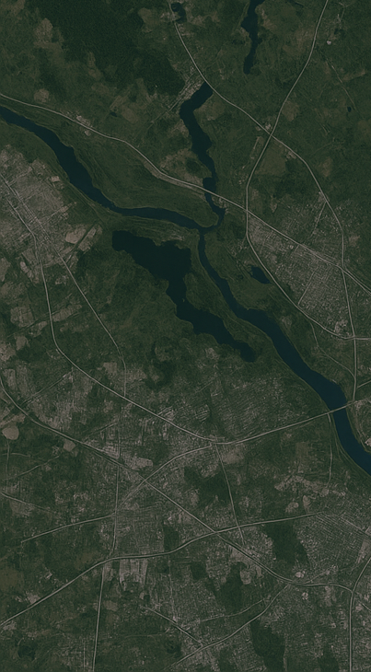

Presented by: Shruti Kumari Hela
Machine Learning
for Wildlife
Harnessing Data to Predict and Protect

Slide 2
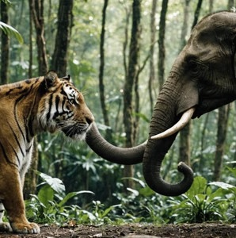
INTRODUCTION
Wildlife plays a crucial role in maintaining biodiversity and ecosystem stability.
Many species are endangered due to human activities, climate change, and habitat destruction.
With the growth of technology, Machine Learning can now support conservation efforts by analyzing animal data.
This project aims to use ML techniques to understand animal characteristics and predict conservation priorities.

Slide 3
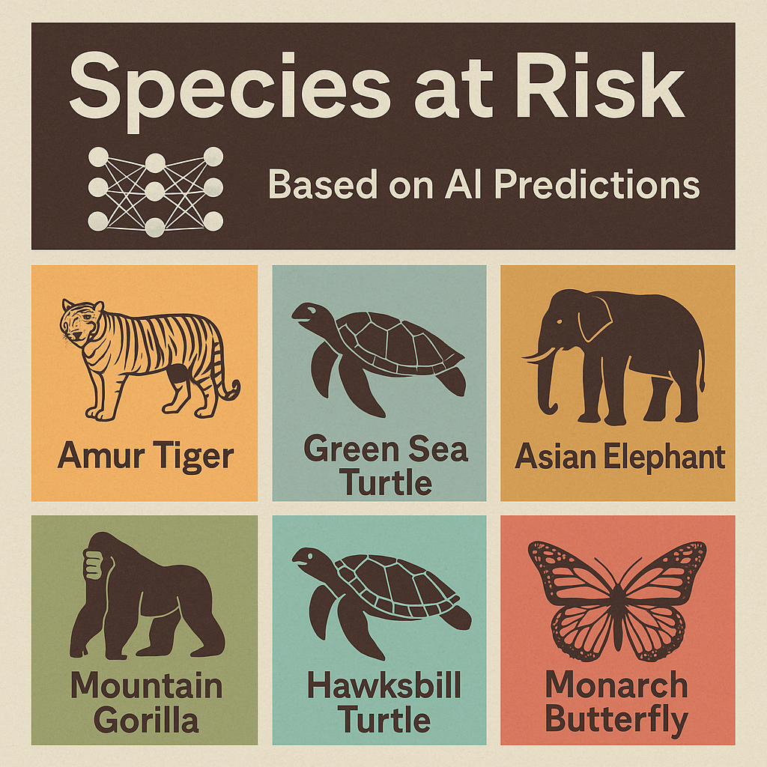
Manufacturing
PROJECT OVERVIEW
Dataset:
Animal_Dataset.csv with 196 unique animals and 16+ features.
Main Goals:
Predict animal lifespan using regression algorithms
Predict conservation status using classification algorithms.
Significance:
Provide data-driven insights that can help inform conservation strategies and prioritize at-risk species

Slide 4

Tools and Technology
Programming: Python
Libraries Used:
pandas & numpy: Data processing
matplotlib & seaborn: Data visualization
scikit-learn: Model building
ML Models Implemented:
Linear Regression (for predicting lifespan)
Logistic Regression, Decision Tree, SVM (for classification)

Slide 5
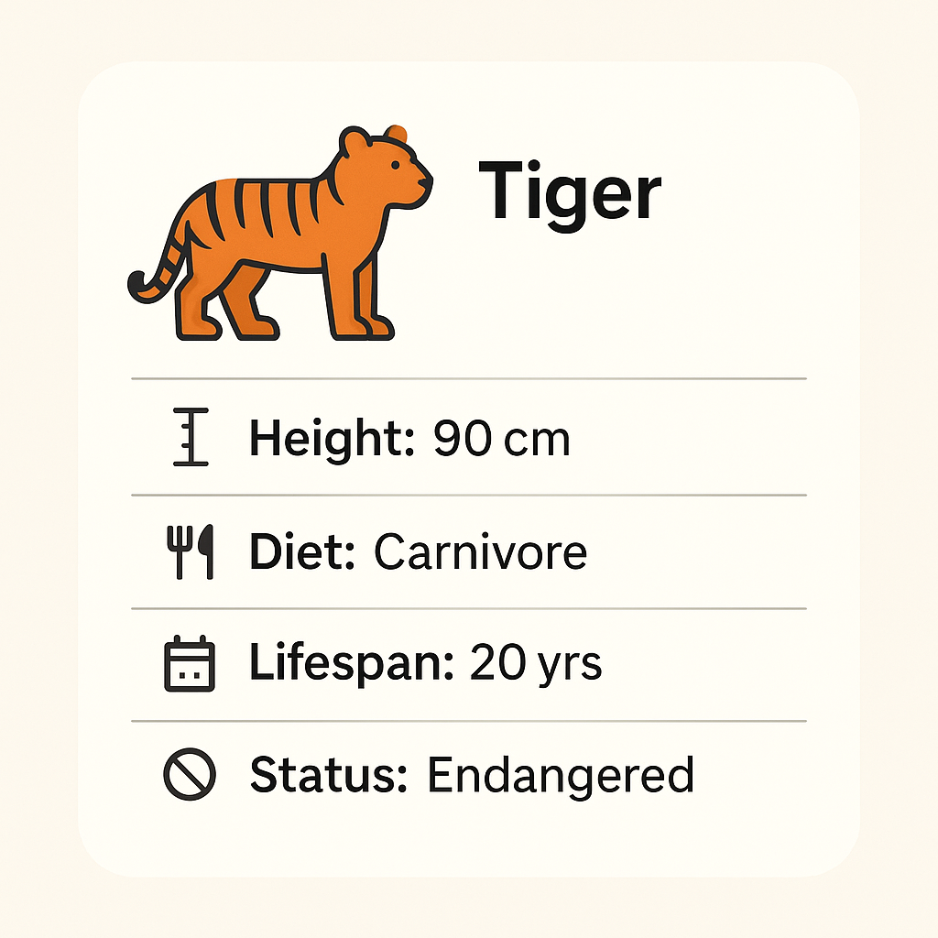
Dataset Features
The dataset includes biological, ecological, and physical traits :
Physical traits: Height, Weight, Top Speed, Average Speed
Biological traits: Lifespan, Gestation Period, Offspring per Birth
Ecological traits: Diet, Habitat, Predators, Social Structure
Targets:
Lifespan (for regression)
Conservation Status (for classification)

Slide 6
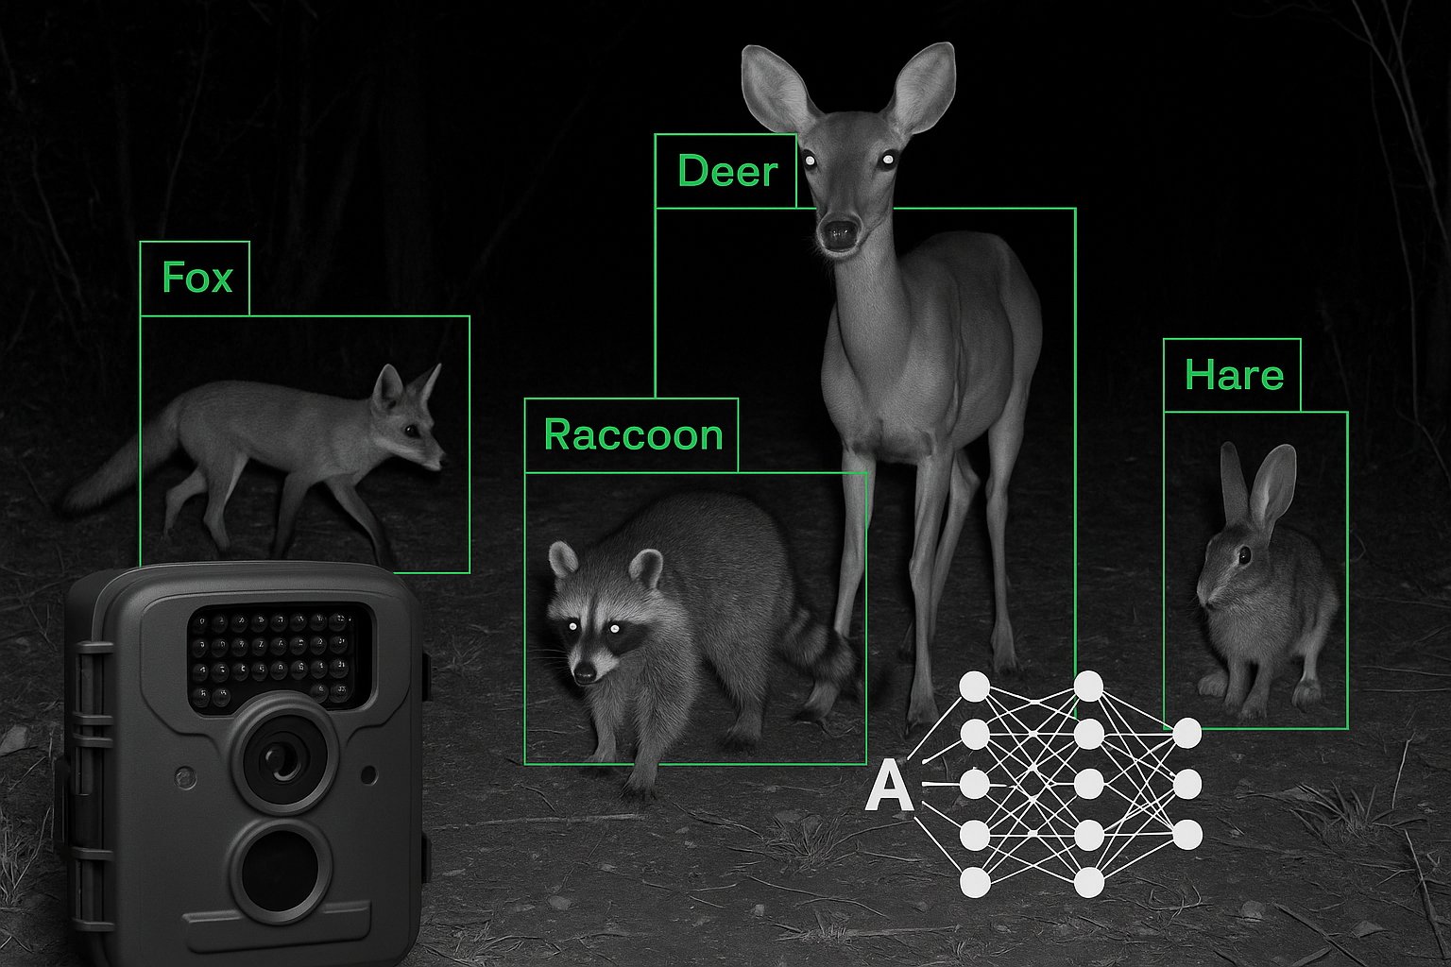
Classification- Conversation Status
Models
Logistic Regression, Decision Tree, SVM
Target
Conversation Satus
Evaluation Metrics
Accuracy, Confusion Matrix, Classification Report

Slide 7
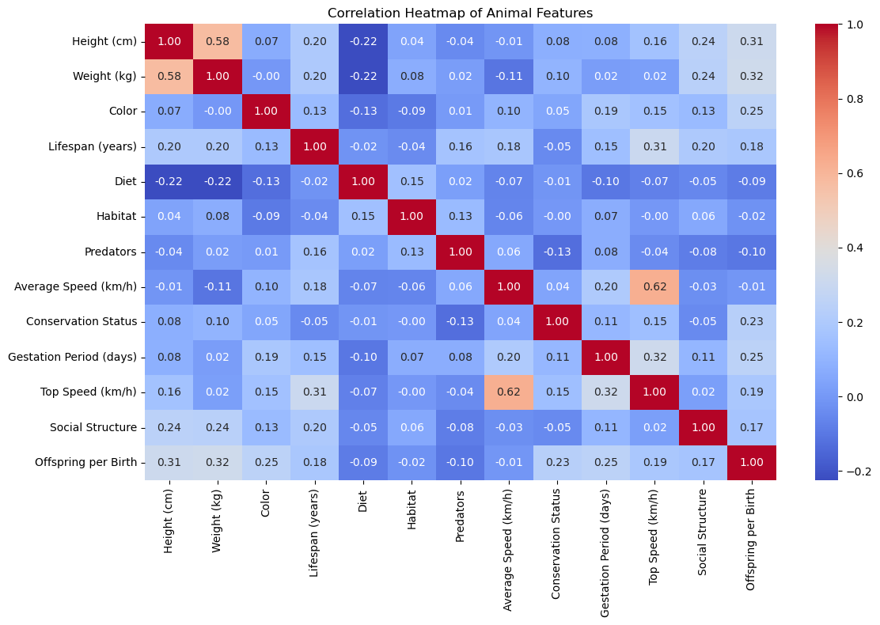
Data Visualization:
Heatmap

Slide 8
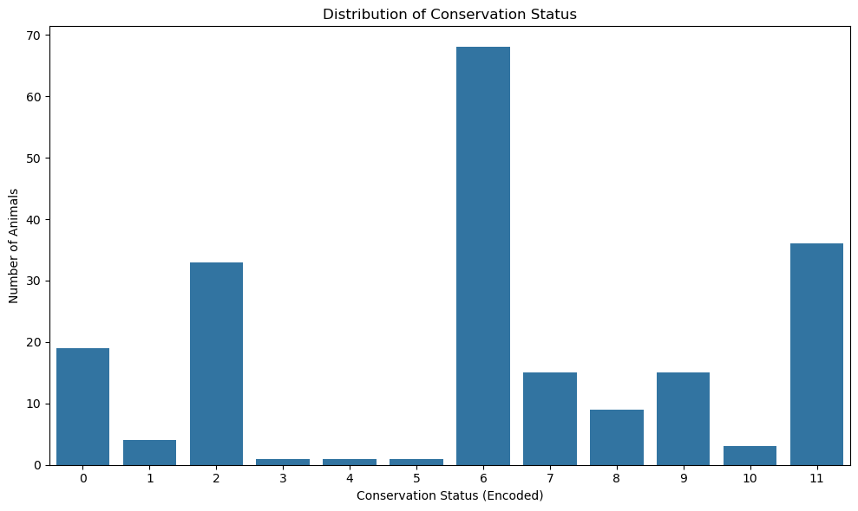
Count plot Conservation
Status
Innovation Solutions

Slide 9
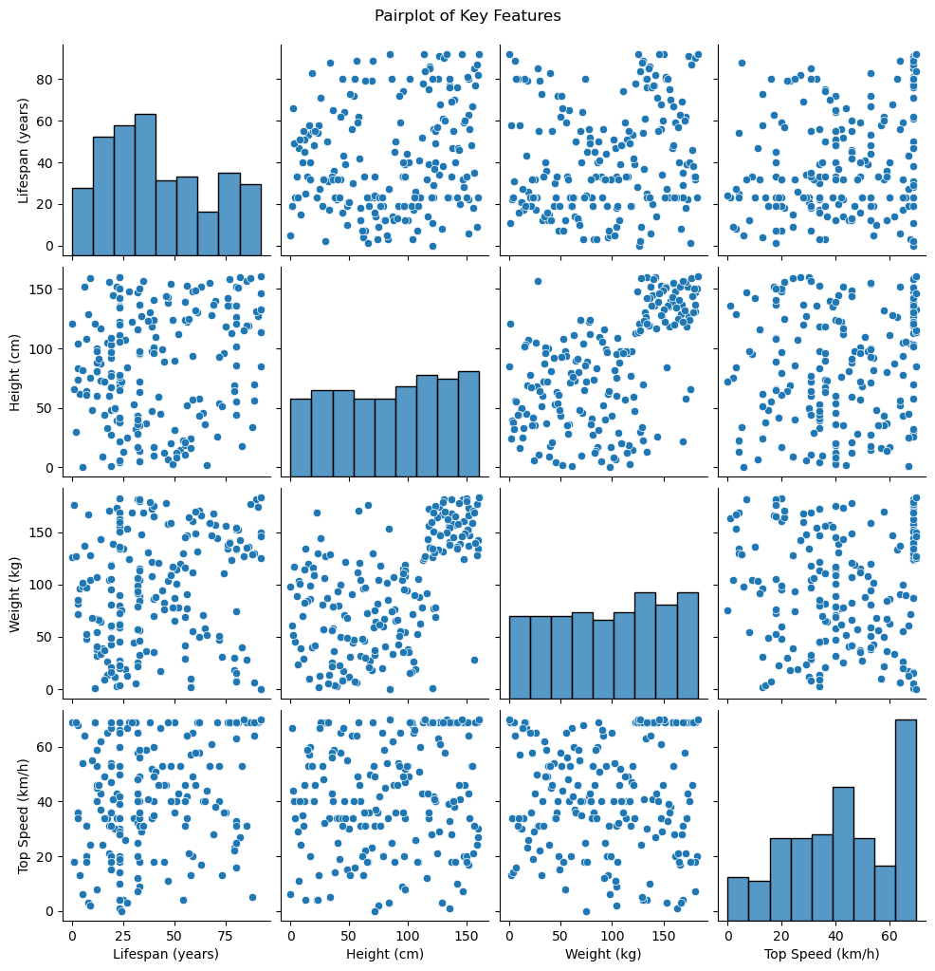
Pairplot of key Numerical Features

Slide 10
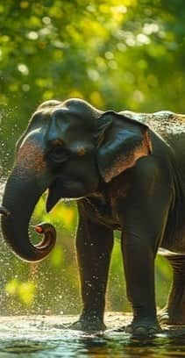
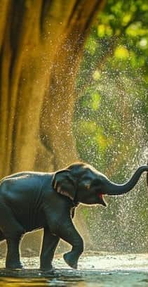
THANK YOU FOR YOUR ATTENTION.

Slide 11
GET IN TOUCH
Name: Shruti Kumari Hela
Phone Number: 6289900352
Email Address: helashruti13@gmail.com
Linkedin: www.linkedin.com/in/shruti-kumari-hela-a90432215

